Slide 1
Cryptography (2021 Fall) statistical distance, perfectly/statistically/computationally indistinguishable, pseudorandom, PRG
LiangFeng Zhang
zhanglf@shanghaitech.edu.cn
SIST, ShanghaiTech

Slide 2

















OTP is IND-EAV
$$m_{0},m_{1}$$
choose $m_{0}, m_{1}∈{\left\{0,1\right\}}^{n}$
$$k←{\left\{0,1\right\}}^{n}$$
$$c←k⊕m_{0}$$
$$Adversary 𝒜$$
$$Challenger$$
$$c$$
$$b^{′}$$
$$m_{0},m_{1}$$
choose $m_{0}, m_{1}∈{\left\{0,1\right\}}^{n}$
$$k←{\left\{0,1\right\}}^{n}$$
$$Challenger$$
$$c←k⊕m_{1}$$
$$Adversary 𝒜$$
$$c$$
$$b^{′}$$
$$k⊕m_{0}≡k⊕m_{1}$$
$$\operatorname{Pr}\left[{out}_{𝒜}(PrivK_{𝒜, OTP}^{eav}\left(n,0\right))=1\right] =\operatorname{Pr}\left[{out}_{𝒜}(PrivK_{𝒜, OTP}^{eav}\left(n,1\right))=1\right]$$

Slide 3
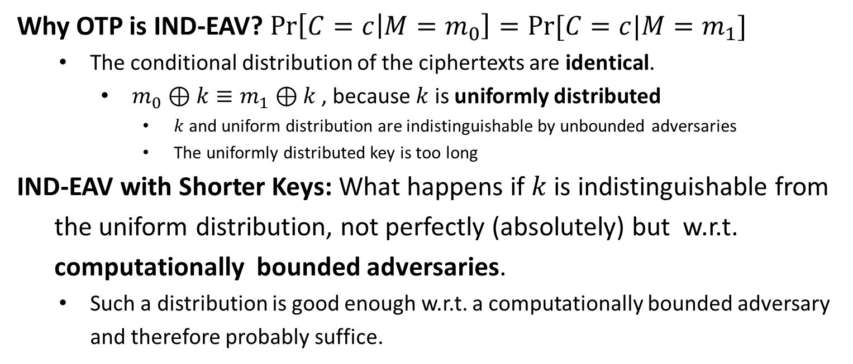
OTP is IND-EAV
Why OTP is IND-EAV? $\operatorname{Pr}\left[C=c | M=m_{0}\right]=Pr⁡[C=c|M=m_{1}]$
The conditional distribution of the ciphertexts are identical.
$m_{0}⊕k≡m_{1}⊕k$ , because $k$ is uniformly distributed
$k$ and uniform distribution are indistinguishable by unbounded adversaries
The uniformly distributed key is too long
IND-EAV with Shorter Keys: What happens if $k$ is indistinguishable from
the uniform distribution, not perfectly (absolutely) but w.r.t.
computationally bounded adversaries.
Such a distribution is good enough w.r.t. a computationally bounded adversary and therefore probably suffice.

Slide 5
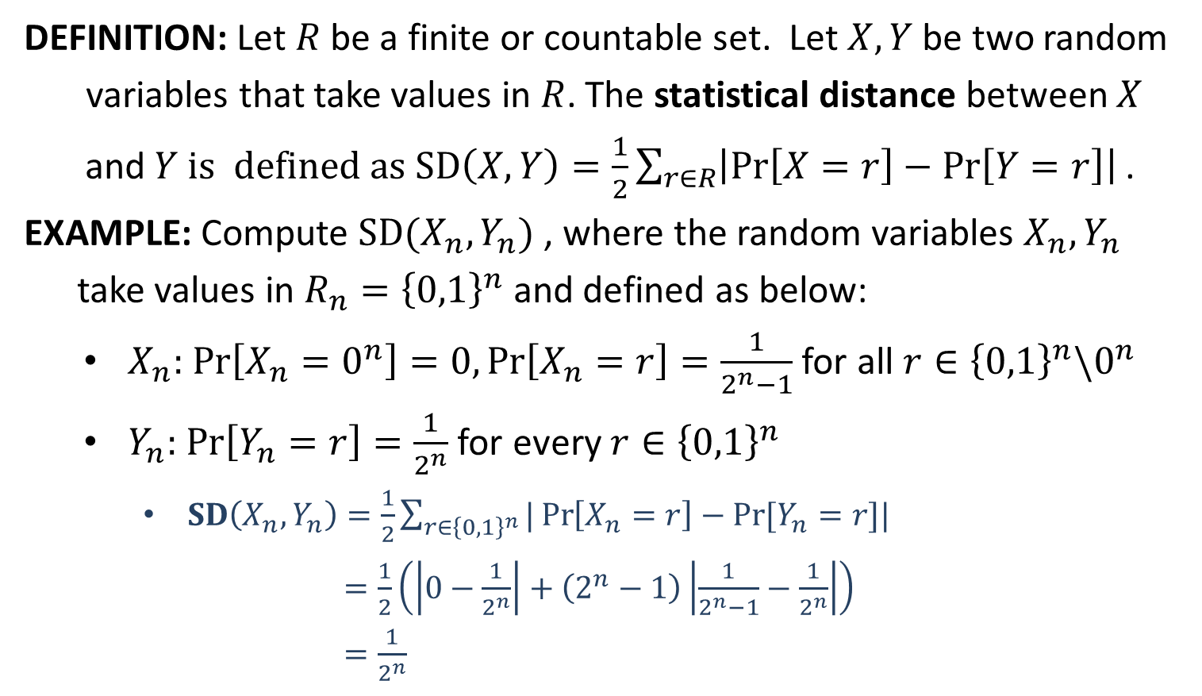
Statistical Distance
DEFINITION: Let $R$ be a finite or countable set. Let $X,Y$ be two random
variables that take values in $R$. The statistical distance between $X$
and $Y$ is defined as $SD\left(X,Y\right)=\frac{1}{2}\sum_{r∈R}{\left|\operatorname{Pr}\left[X=r\right]−\operatorname{Pr}\left[Y=r\right]\right| }$.
EXAMPLE: Compute $SD(X_{n},Y_{n})$ , where the random variables $X_{n},Y_{n}$
take values in $R_{n}={\left\{0,1\right\}}^{n}$ and defined as below:
$X_{n}:$ $\operatorname{Pr}\left[X_{n}=0^{n}\right]=0,\operatorname{Pr}\left[X_{n}=r\right]=\frac{1}{2^{n}−1}$ for all $r∈{\left\{0,1\right\}}^{n}\backslash 0^{n}$
$Y_{n}:$ $\operatorname{Pr}\left[Y_{n}=r\right]=\frac{1}{2^{n}}$ for every $r∈{\left\{0,1\right\}}^{n}$
$SD\left(X_{n},Y_{n}\right)=\frac{1}{2}\sum_{r∈{\left\{0,1\right\}}^{n}}{|\operatorname{Pr}\left[X_{n}=r\right]−Pr⁡[Y_{n}=r]|}$
$=\frac{1}{2}\left(\left|0−\frac{1}{2^{n}}\right|+\left(2^{n}−1\right)\left|\frac{1}{2^{n}−1}−\frac{1}{2^{n}}\right|\right)$
$=\frac{1}{2^{n}}$

Slide 6
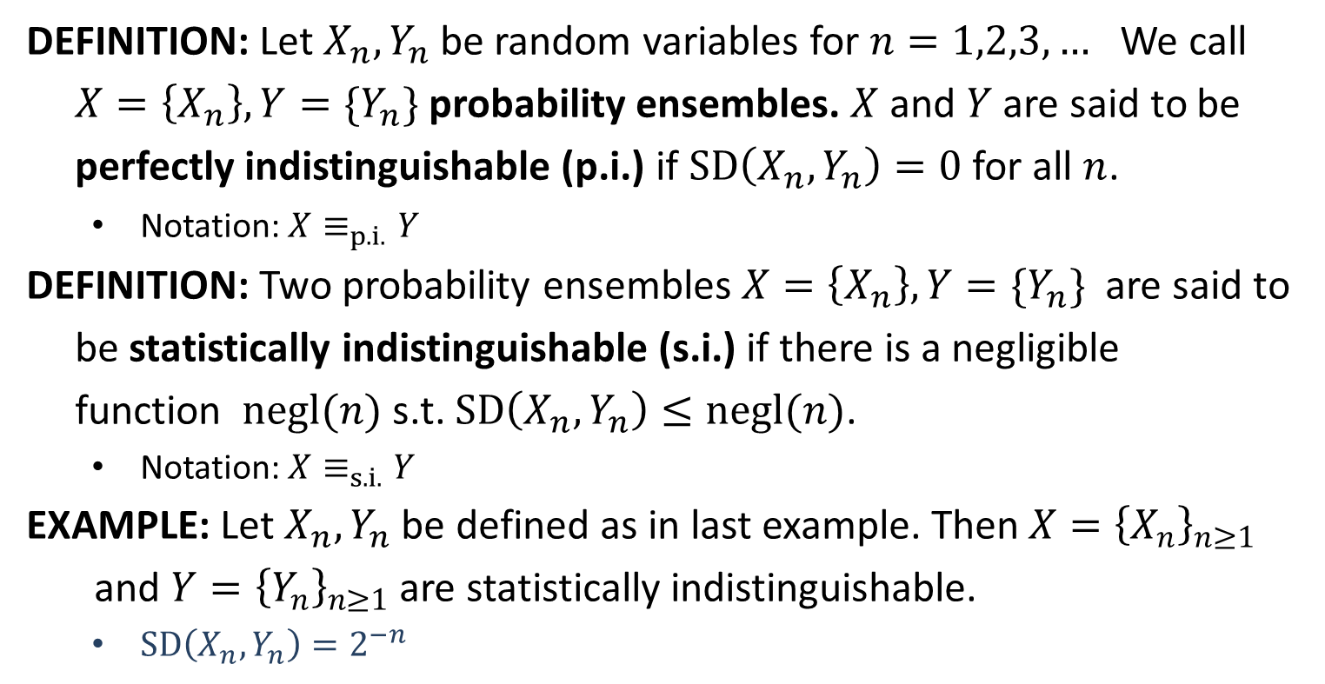
Perfect/Statistical Indistinguishable
DEFINITION: Let $X_{n},Y_{n}$ be random variables for $n=1,2,3,…$ We call
$X=\left\{X_{n}\right\}, Y=\{Y_{n}\}$ probability ensembles. $X$ and $Y$ are said to be
perfectly indistinguishable (p.i.) if $SD\left(X_{n},Y_{n}\right)=0$ for all $n$.
Notation: $X≡_{p.i.}Y$
DEFINITION: Two probability ensembles $X=\left\{X_{n}\right\}, Y=\{Y_{n}\}$ are said to
be statistically indistinguishable (s.i.) if there is a negligible
function $negl(n)$ s.t. $SD\left(X_{n},Y_{n}\right)≤negl(n)$.
Notation: $X≡_{s.i.}Y$
EXAMPLE: Let $X_{n}, Y_{n}$ be defined as in last example. Then$X={\left\{X_{n}\right\}}_{n≥1}$
and $Y={\left\{Y_{n}\right\}}_{n≥1}$ are statistically indistinguishable.
$SD\left(X_{n},Y_{n}\right)=2^{−n}$

Slide 7
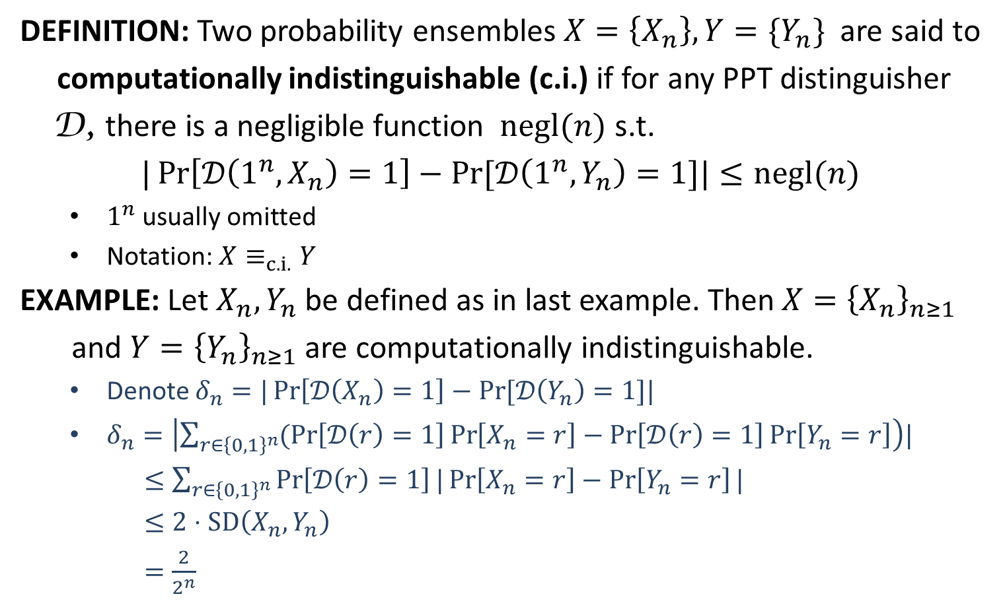
Computational Indistinguishable
DEFINITION: Two probability ensembles $X=\left\{X_{n}\right\}, Y=\{Y_{n}\}$ are said to
computationally indistinguishable (c.i.) if for any PPT distinguisher
D, there is a negligible function $negl(n)$ s.t.
$|\operatorname{Pr}\left[𝒟\left(1^{n},X_{n}\right)=1\right]−Pr⁡[𝒟\left(1^{n},Y_{n}\right)=1]|≤negl(n)$
$1^{n}$ usually omitted
Notation: $X≡_{c.i.}Y$
EXAMPLE: Let $X_{n}, Y_{n}$ be defined as in last example. Then$X={\left\{X_{n}\right\}}_{n≥1}$
and $Y={\left\{Y_{n}\right\}}_{n≥1}$ are computationally indistinguishable.
Denote $δ_{n}=|\operatorname{Pr}\left[𝒟\left(X_{n}\right)=1\right]−Pr⁡[𝒟\left(Y_{n}\right)=1]|$
$δ_{n}=\left|\sum_{r∈{\left\{0,1\right\}}^{n}}{(\operatorname{Pr}\left[𝒟\left(r\right)=1\right]}\operatorname{Pr}\left[X_{n}=r\right]−\operatorname{Pr}\left[𝒟\left(r\right)=1\right]\operatorname{Pr}\left[Y_{n}=r\right]\right)|$
$≤\sum_{r∈{\left\{0,1\right\}}^{n}}{\operatorname{Pr}\left[𝒟\left(r\right)=1\right]}|\operatorname{Pr}\left[X_{n}=r\right]−\operatorname{Pr}\left[Y_{n}=r\right]|$
$≤2⋅SD\left(X_{n},Y_{n}\right)$
$=\frac{2}{2^{n}}$

Slide 8
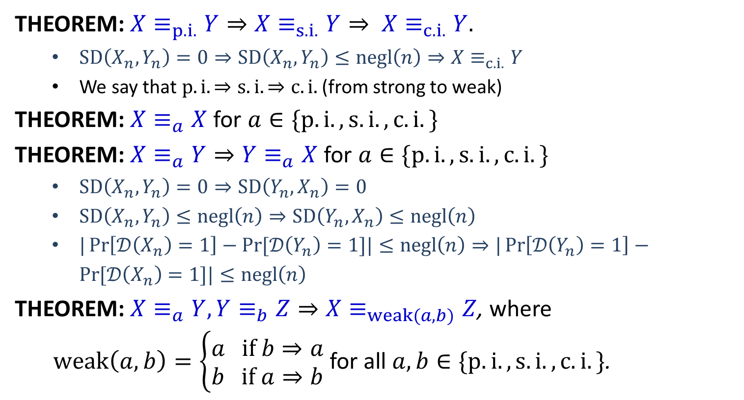
Connections
THEOREM: $X≡_{p.i.}Y⇒X≡_{s.i.}Y⇒ X≡_{c.i.}Y.$
$SD\left(X_{n},Y_{n}\right)=0⇒SD\left(X_{n},Y_{n}\right)≤negl\left(n\right)⇒X≡_{c.i.}Y$
We say that $p.i. ⇒s.i. ⇒c.i.$ (from strong to weak)
THEOREM: $X≡_{a}X$ for $a∈\{p.i., s.i., c.i.\}$
THEOREM: $X≡_{a}Y⇒Y≡_{a}X$ for $a∈\{p.i., s.i., c.i.\}$
$SD\left(X_{n},Y_{n}\right)=0⇒SD\left(Y_{n},X_{n}\right)=0$
$SD\left(X_{n},Y_{n}\right)≤negl\left(n\right)⇒SD\left(Y_{n},X_{n}\right)≤negl\left(n\right)$
$|\operatorname{Pr}\left[𝒟\left(X_{n}\right)=1\right]−Pr⁡[𝒟\left(Y_{n}\right)=1]|≤negl\left(n\right)⇒|\operatorname{Pr}\left[𝒟\left(Y_{n}\right)=1\right]−Pr⁡[𝒟\left(X_{n}\right)=1]|≤negl\left(n\right)$
THEOREM: $X≡_{a}Y, Y≡_{b}Z⇒X≡_{weak(a,b)}Z$, where
$weak\left(a,b\right)=\left\{\begin{aligned}a if b⇒a \\ b if a⇒b\end{aligned}\right.$ for all $a,b∈\{p.i., s.i., c.i.\}$.

Slide 10
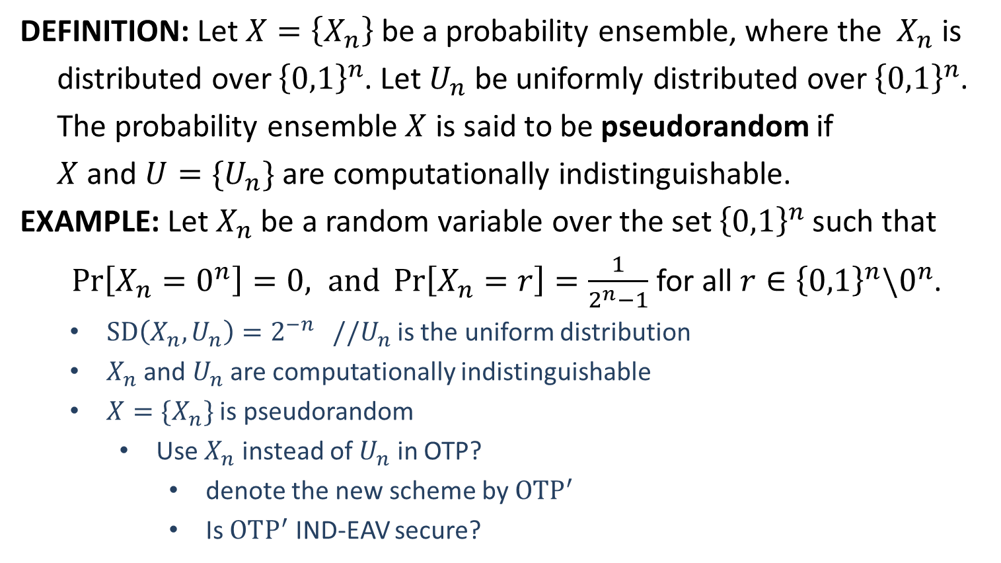
Pseudorandomness
DEFINITION: Let $X=\left\{X_{n}\right\}$be a probability ensemble, where the $X_{n}$ is
distributed over ${\left\{0,1\right\}}^{n}$. Let $U_{n}$ be uniformly distributed over ${\left\{0,1\right\}}^{n}$.
The probability ensemble $X$ is said to be pseudorandom if
$X$ and $U=\{U_{n}\}$ are computationally indistinguishable.
EXAMPLE: Let $X_{n}$ be a random variable over the set ${\left\{0,1\right\}}^{n}$ such that
$\operatorname{Pr}\left[X_{n}=0^{n}\right]=0, and \operatorname{Pr}\left[X_{n}=r\right]=\frac{1}{2^{n}−1}$ for all $r∈{\left\{0,1\right\}}^{n}\backslash 0^{n}$.
$SD\left(X_{n},U_{n}\right)=2^{−n}$ //$U_{n}$ is the uniform distribution
$X_{n}$ and $U_{n}$ are computationally indistinguishable
$X=\{X_{n}\}$ is pseudorandom
Use $X_{n}$ instead of $U_{n}$ in OTP?
denote the new scheme by $OTP^{′}$
Is $OTP^{′}$ IND-EAV secure?

Slide 11
IND-EAV from Pseudorandomness
$$m_{0},m_{1}$$
$$m_{0},m_{1}$$
$$k←X_{n}$$
$$k←{\left\{0,1\right\}}^{n}$$
$$c_{1}=k⊕m_{0}$$
$$c_{1}$$
$${c_{1}≡}_{s.i.}c_{2}$$
$$c_{2}=k⊕m_{0}$$
$$c_{2}$$
$$b^{′}$$
$$b^{′}$$
challenger
$$𝒜$$
challenger
$$𝒜$$
$${c_{1}≡}_{s.i.}c_{4}$$
$$c_{2}≡_{p.i.}c_{3}$$
$$m_{0},m_{1}$$
$$m_{0},m_{1}$$
$$k←X_{n}$$
$$k←{\left\{0,1\right\}}^{n}$$
$$c_{4}=k⊕m_{1}$$
$$c_{4}$$
$${c_{4}≡}_{s.i.}c_{3}$$
$$c_{3}=k⊕m_{1}$$
$$c_{3}$$
$$b^{′}$$
$$b^{′}$$
challenger
$$𝒜$$
challenger
$$𝒜$$
IND-EAV secure
$\left|k\right|=\log_{2}{(2^{n}−1)}<n$ bits
$$PrivK_{𝒜, OTP^{′}}^{eav}\left(n,b\right)$$
$$PrivK_{𝒜, OTP}^{eav}\left(n,b\right)$$

Slide 13
Pseudorandom Generator (PRG)
DEFINITION: A function $G:{\left\{0,1\right\}}^{n}→{\left\{0,1\right\}}^{l(n)}$ is called a pseudorandom
generator (PRG) if it satisfies the following conditions:
efficiently computable: there is a deterministic polynomial-time algorithm $D$ such that $D\left(x\right)=G(x)$ for all $x∈{\left\{0,1\right\}}^{n}$
expansion: $l\left(n\right)>n$ for all $n∈ℕ$
$l$is called the expansion factor of $G$
pseudorandomness: $G(U_{n})$ is pseudorandom, where $U_{n}$ is uniformly distributed over ${\left\{0,1\right\}}^{n}$
$∀$ PPT algorithm $𝒟$, $∃$ a negligible function $negl(⋅)$ s.t.
$|Pr⁡[𝒟\left(G\left(U_{n}\right)\right)=1]−Pr⁡[𝒟\left(U_{l(n)}\right)=1]|≤negl(n)$

Slide 14
Understanding PRG
REMARK: The output distribution of a PRG looks uniform.
EXAMPLE: The function $G:{\left\{0,1\right\}}^{n}→{\left\{0,1\right\}}^{n+1}$ defined by
$G\left(s_{1}s_{2}⋯s_{n}\right)=s_{1}s_{2}⋯s_{n}(⊕_{i}s_{i})$
is not a PRG.
Design a PPT algorithm $𝒟$ to distinguish between $G(U_{n})$ and $U_{n+1}$
INPUT: $x∈{\left\{0,1\right\}}^{n+1}$ // $x←G(U_{n})$ or $x←U_{n+1}$
Output $1$ if $x_{n+1}=⊕_{i=1}^{n}x_{i}$; otherwise, output $0$.
Analysis:
$Pr\left[𝒟\left(G(U_{n})\right)=1\right]=\underset{x←G(U_{n})}{Pr}\left[𝒟\left(x\right)=1\right]=1$
$Pr\left[𝒟\left(U_{n+1}\right)=1\right]=\underset{x←U_{n+1}}{Pr}\left[𝒟\left(x\right)=1\right]=\underset{x←U_{n+1}}{Pr}\left[x_{n+1}=⊕_{i=1}^{n}x_{i}\right]=\frac{1}{2}$
$|\operatorname{Pr}\left[𝒟\left(G\left(U_{n}\right)\right)=1\right]−Pr⁡[𝒟\left(U_{n+1}\right)=1]|=\frac{1}{2}$, non-negligible
$\{G\left(U_{n}\right)\}$ is not pseudorandom
$G$ is not a PRG

